Slide 1


Drum: A Rhythmic Approach to Interactive Analytics on Large Data
Jianfeng Jia, Chen Li, Michael Carey
Cloudberry

Slide 2
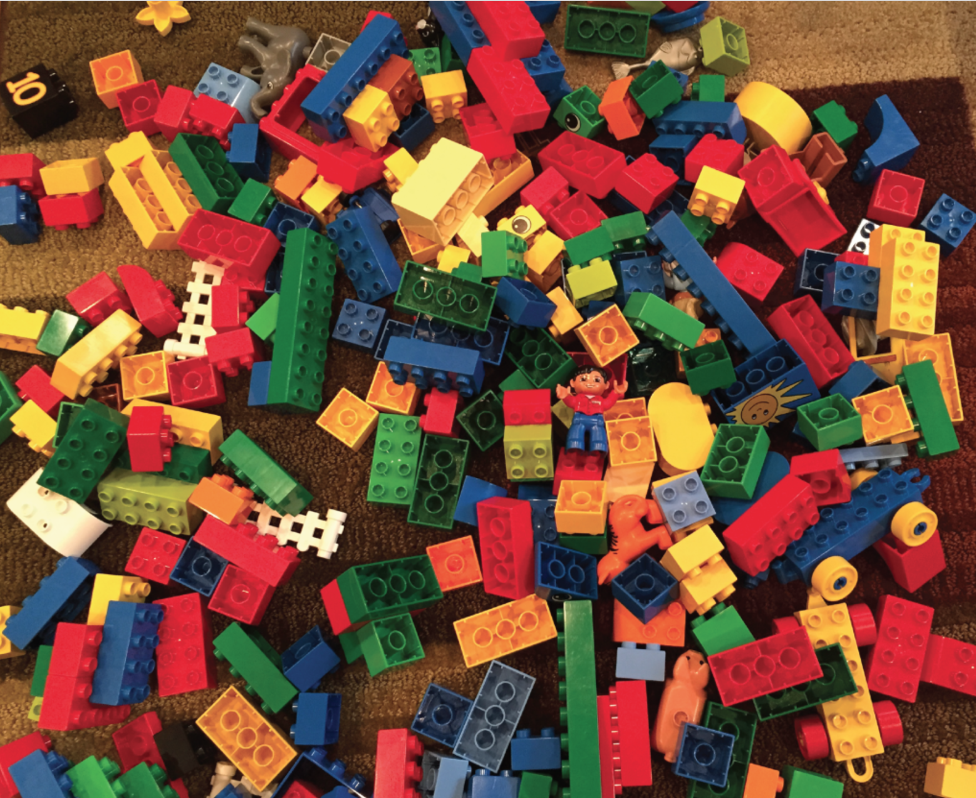
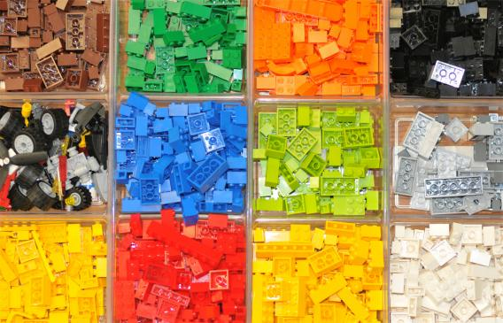
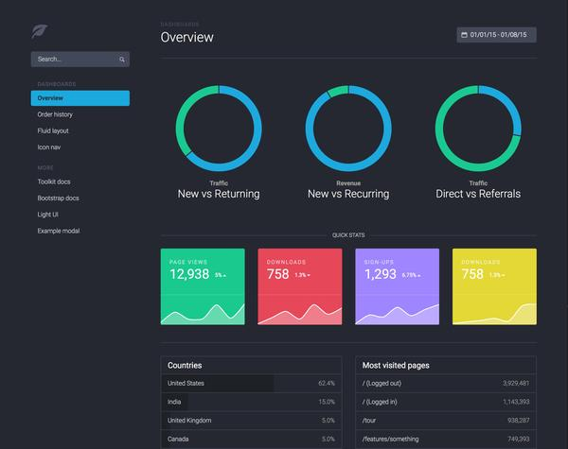
Understand Big Data
Notes:
story!

Slide 3
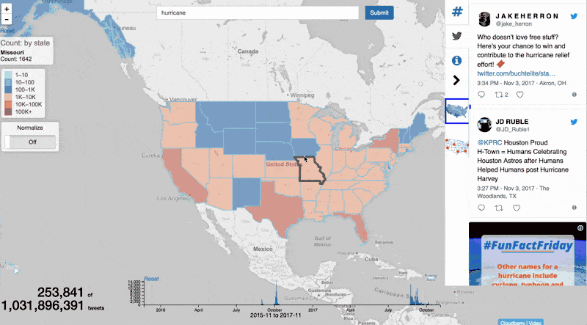
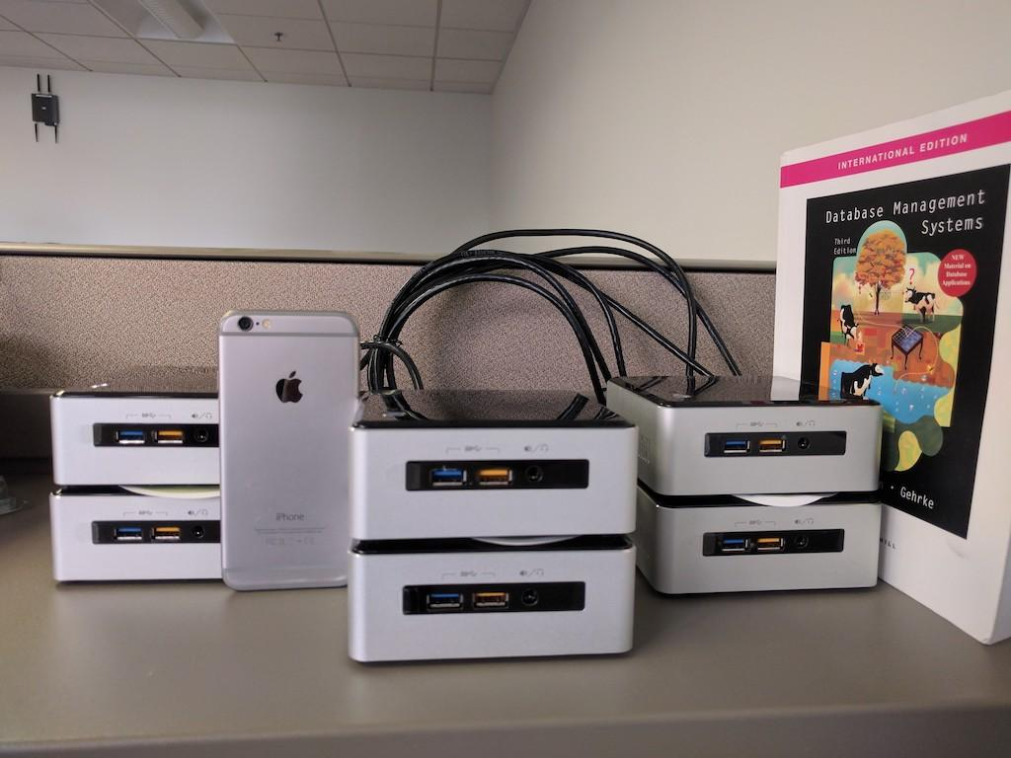
Visualize One Billion Tweets Under $4,000

Slide 4
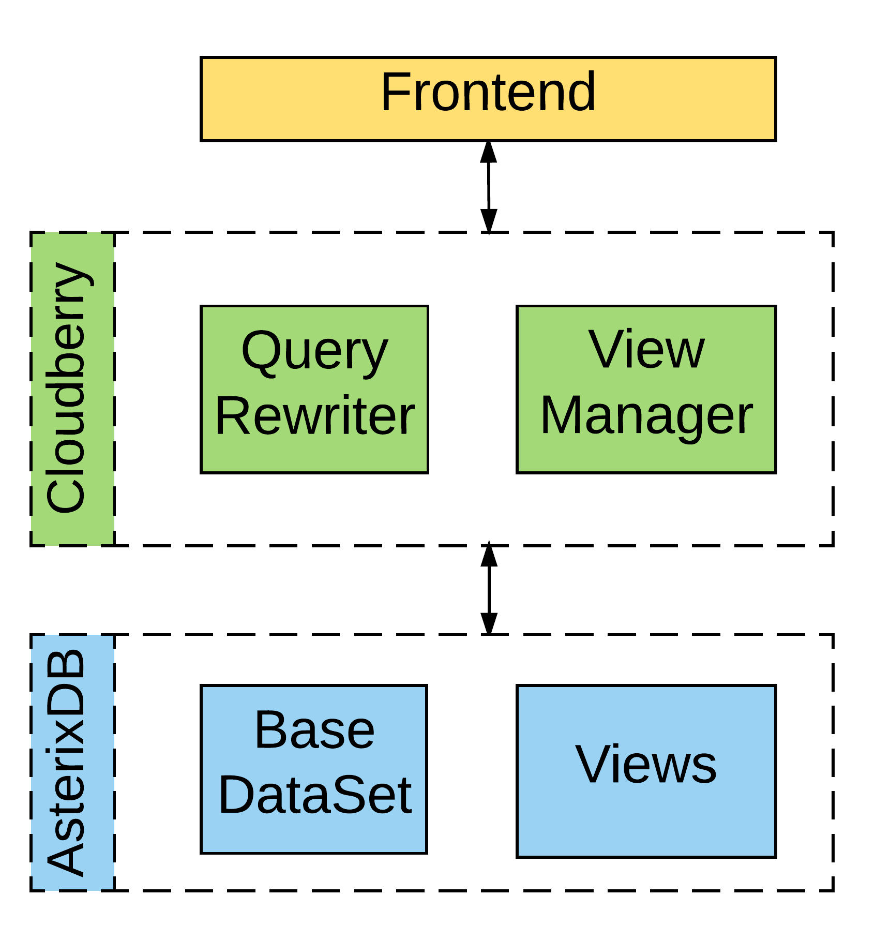
Architecture

Slide 5
Latency Issue
Views are not always available
2TB data: large
Aggregation queries: expensive

Slide 6
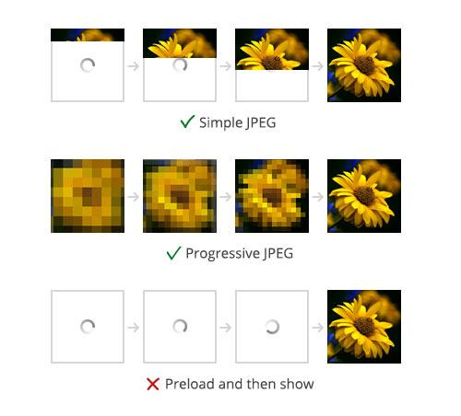
Progressive Computing

Slide 7
Query Slicing
Q → mini-queries Q₁,Q₂,...Q_{i}
Each Q_{i} has an additional range condition on the slicing attribute (e.g. time)
r_{i} : size of range condition
SELECT state, COUNT(*)
FROM twitter t
WHERE contains(t.text, "election")
GROUP BY state;
Q:
2017-01-01
2017-04-01
2017-09-01
2017-12-14
Data
Q₃
Q₂
Q₁
Notes:
each mini-query accesses a specific portion of the data to answer the question partially, then the middleware can combine the results and send it to the front-end, that the ui interface can be updated progressively.
For example
As a result, show the gif

Slide 8
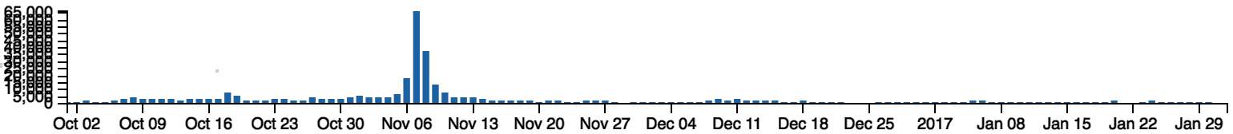
Fixed-length Slicing?
Difficult to fix the length
DB performance can fluctuate
Skewed distribution
Daily distribution of tweets mentioning “election”

Slide 9
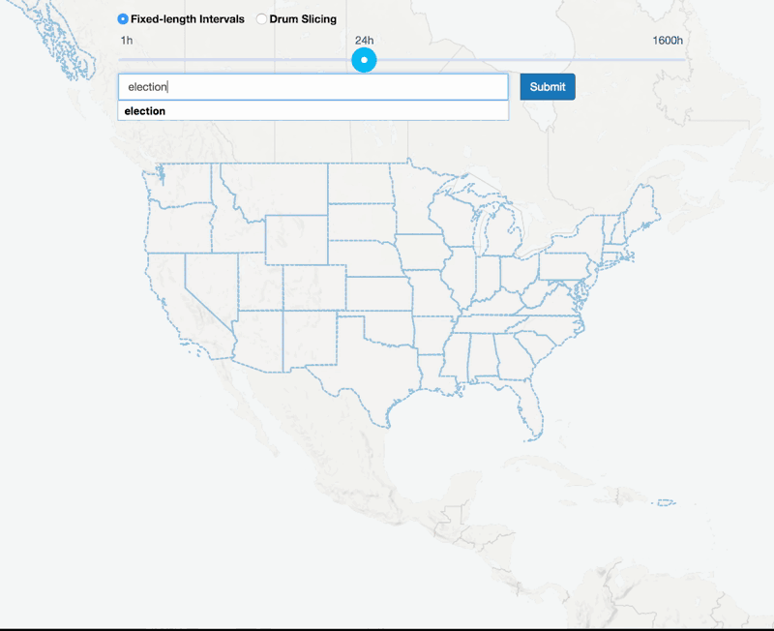
Fix-length Slicing User Experience
Notes:
how to slice?

Slide 10
What Is A Good Slicing Schedule?
Q
seconds
0
1
2
3
4
5
6
7
8
9
Schedule S₁
Q₁
Q₂
Q₃
Q₄
seconds
0
1
2
3
4
5
6
7
8
9
Schedule S₂
Q₁
Q₂
Q₃
Q₄
seconds
0
1
2
3
4
5
6
7
8
9
Schedule S₃

Slide 11
Measuring Schedule Cost
Total running time
Smoothness of result delivery
Q_{i-1}
Q_{i}
U_{i-1}
U_{i}
Q_{i-1} finished
P:Pace
D_{i}:Delay of Q_{i}
Q_{i-1} results delivered
α : Penalty weight
Notes:
the smoothness is measured by the sum of delay of the miniqueries that fail to update the result at the required pace.
The required pace is pre-decided by the user which defines the interval between two adjacent updates.
in this case, the middleware can choose to wait till Ui-1 to delivery the result.
The overall cost of a schedule is quantified by the summation of the total running time and the weighted penalties.

Slide 12
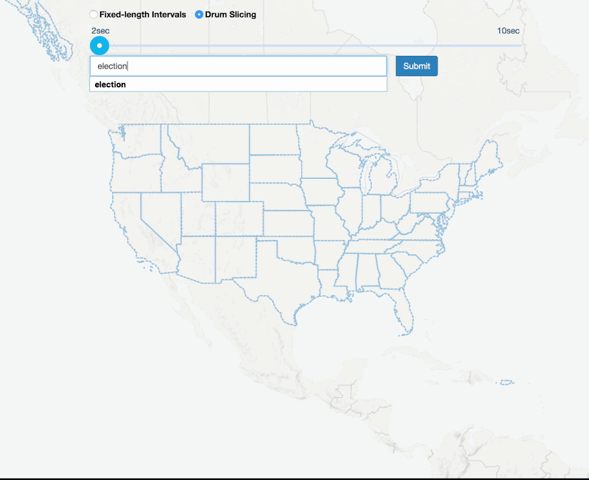
Query Slicing with A Rhythm
Notes:
users can get early response without waiting for the query to complete.

Slide 13
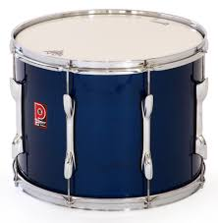
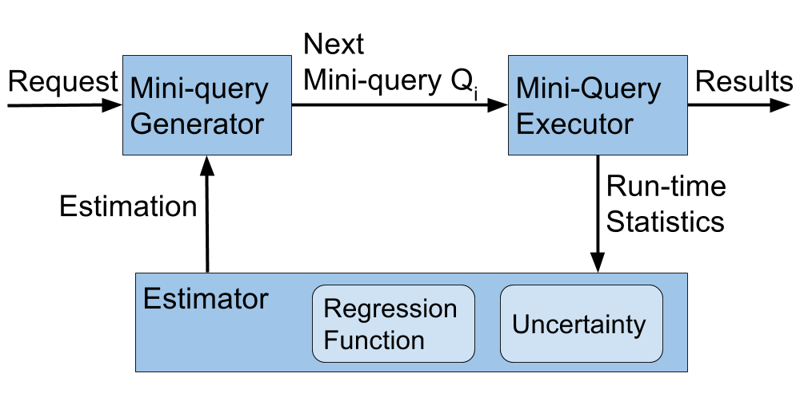
Drum: Adaptive Framework for Query Slicing
Notes:
having defined what is a good schedule, let introduce how to realize such a good schedule.
drum can dynamically decide the condition on the slicing attribute for each mini-query.
to help the generator to create the next mini-query
regression function is used to capture the relationship between the slicing predicate range size and the corresponding query running time.
the uncertainty model is used to measure the distribution of the prediction error of the regression function.

Slide 14
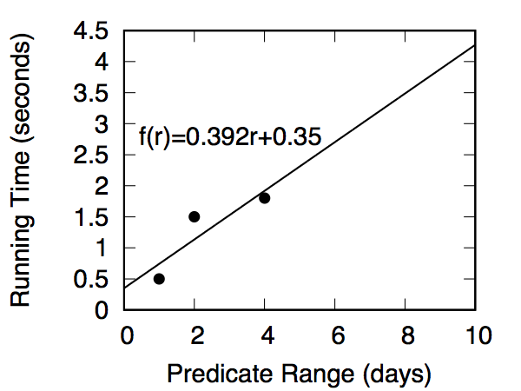
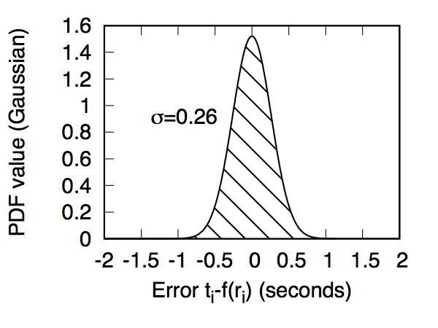
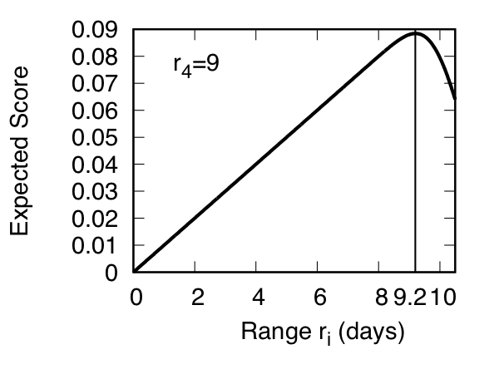
Example: choose Q₄
Q₁
1 day
Q₂
2days
Q₃
4days
Q₄ = ?
seconds
0
0.5
1
3
3.8
5
6
7
8
9
2
4
2
L₁=2
L₂=3.5
L₃=4
L₄=4.2
Notes:
main example is good enough.

Slide 15
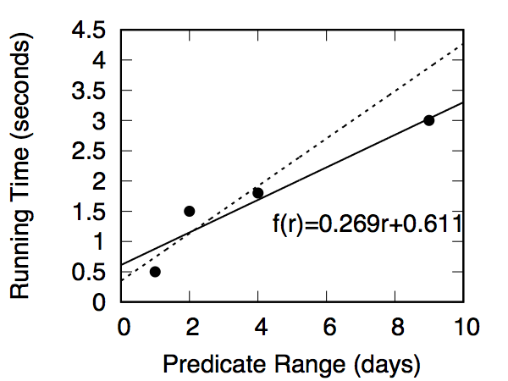
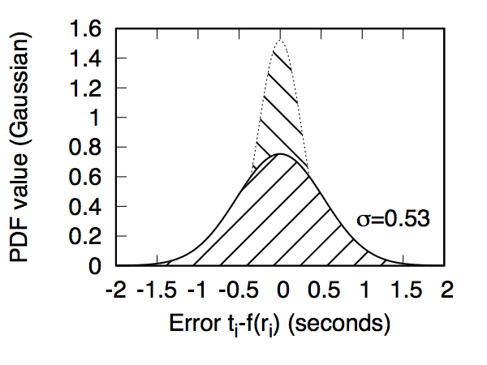
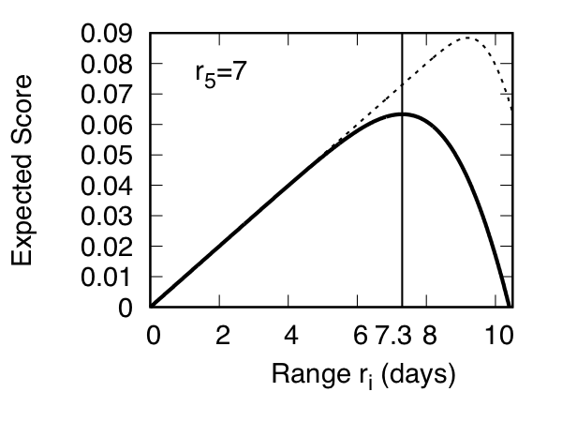
Example: choose Q₅
Q₁
1 day
Q₂
2days
Q₃
4days
Q₄
9days
Q₅=?
seconds
0
0.5
1
3.8
6.8
2
3
4
5
6
7
8
9
2
L₁=2
L₂=3.5
L₃=4
L₄=4.2
L₅=3.2

Slide 16
More results in the paper
Formulate an optimization problem
Develop an adaptive framework
Define a score function to maximize the gain for each slice

Slide 17
Experimental setting
Data: 114 million tweets (90GB), Nov. 2016 to Jan. 2017
DB: AsterixDB 0.9.2
Index on “create_at” field
Inverted index on “text” field
Single machine, 4 cores, 16GB memory
with the middleware server
Queries:
SELECT state, COUNT(*)
FROM twitter t
WHERE contains(t.text, $keyword)
GROUP BY state;

Slide 18
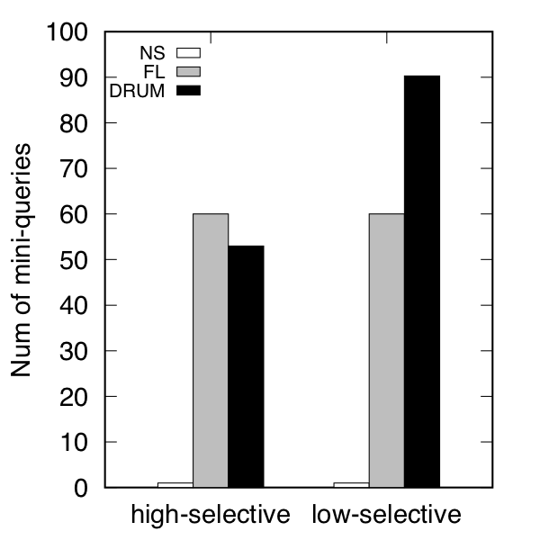
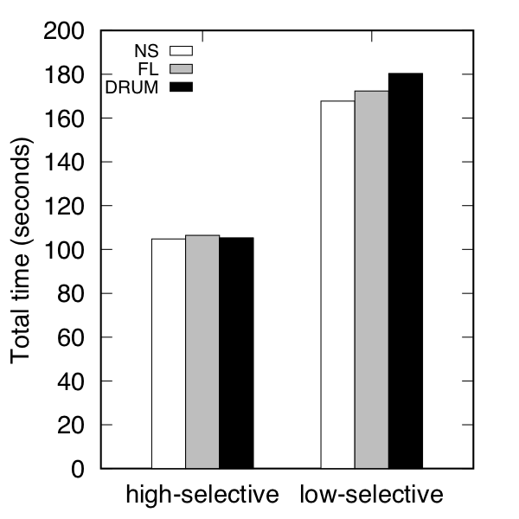
# of mini-queries and total running time
little overhead
Notes:
good: slicing doesn’t introduce much overhead.

Slide 19
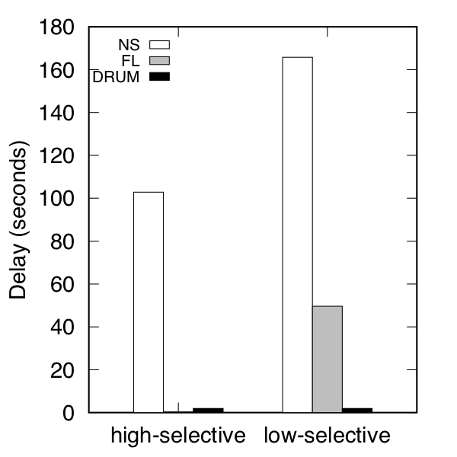
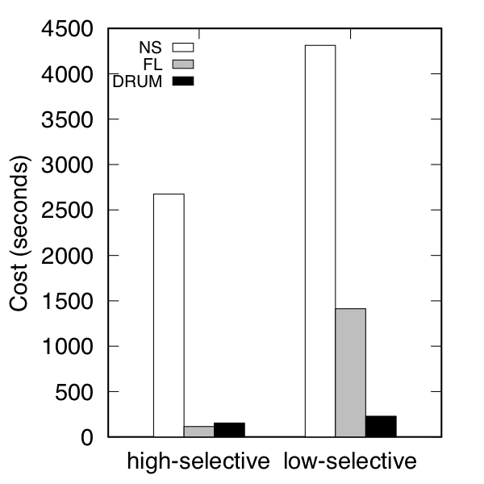
Total delay and overall cost
α=25

Slide 20
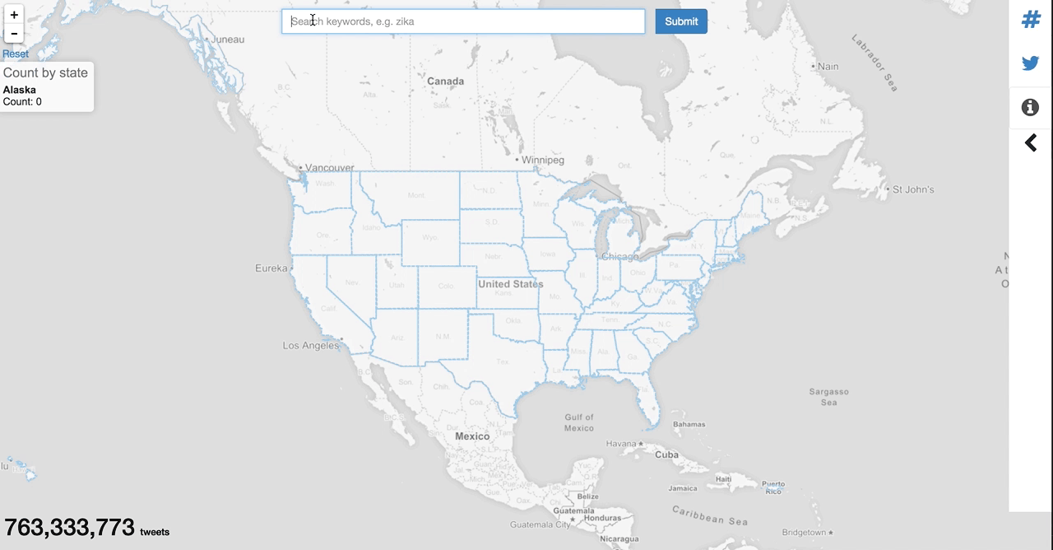
Conclusions
Problem: query slicing to answer big queries responsively
Solution: Drum, slicing on a dimension adaptively

Slide 21
Cloudberry Project
Generic middleware
Real-time analytics and visualization on big data
Using materialized views and query slicing
Supporting different frontends and backend DBs
http://cloudberry.ics.uci.edu/

Slide 22

Thank you!
Drum: A Rhythmic Approach to Interactive Analytics on Large Data

Slide 23
backup

Slide 24
Related Work
Existing work
Progressive Computing
Waiting time in progressive computation
Query time estimation
Main difference
middleware solution: treat DB as a “black box”
rhythmic slicing

Slide 25
Query Slicing with A Rhythm
Notes:
users can get early response without waiting for the query to complete.

Slide 26
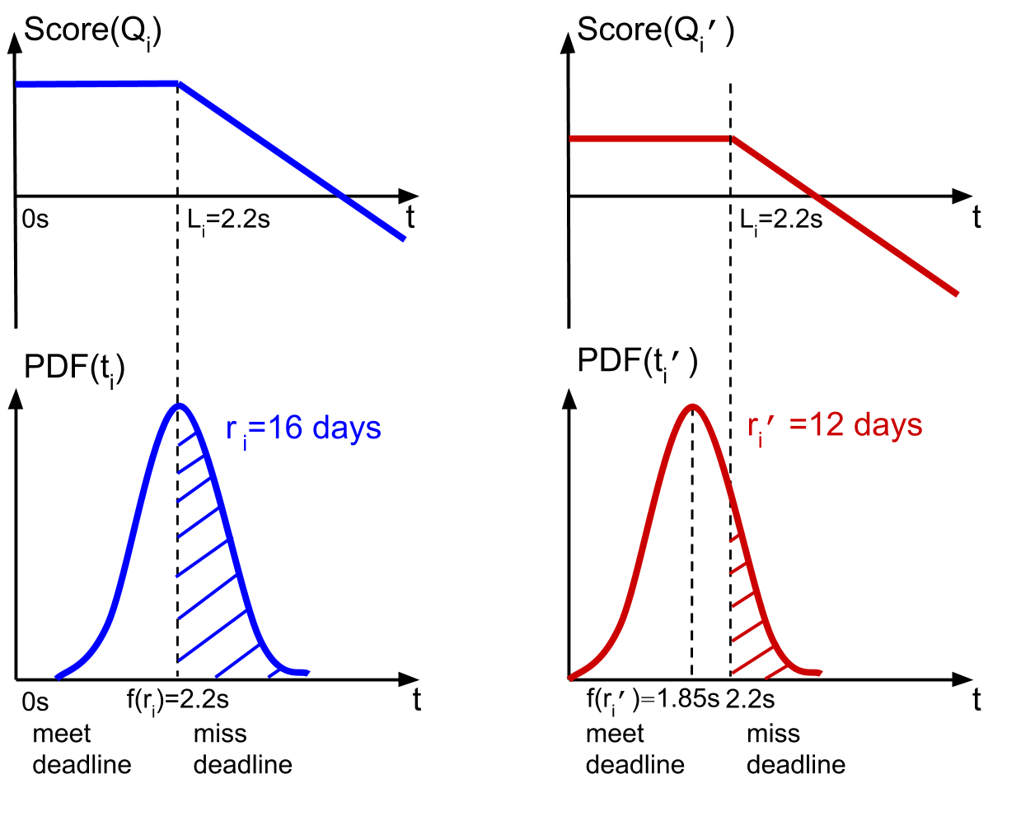
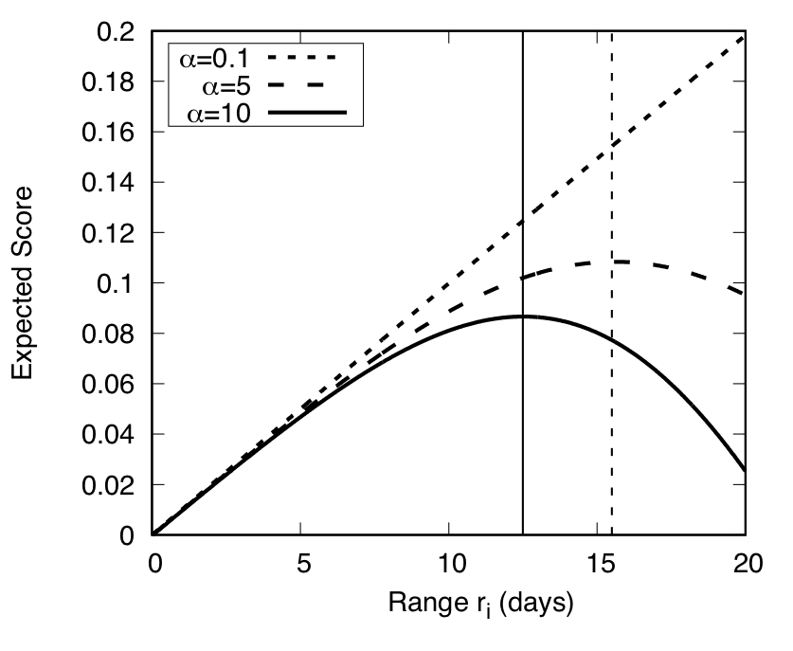
Tradeoff of Running Time and Penalty
Notes:
having defined what is a good schedule, let introduce how to realize such a good schedule.
drum can dynamically decide the condition on the slicing attribute for each mini-query.
to help the generator to create the next mini-query
regression function is used to capture the relationship between the slicing predicate range size and the corresponding query running time.
the uncertainty model is used to measure the distribution of the prediction error of the regression function.

Slide 27
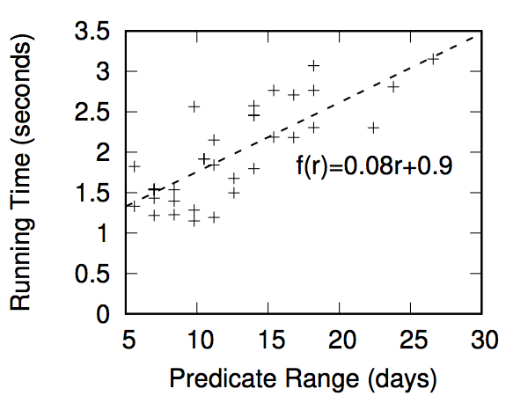
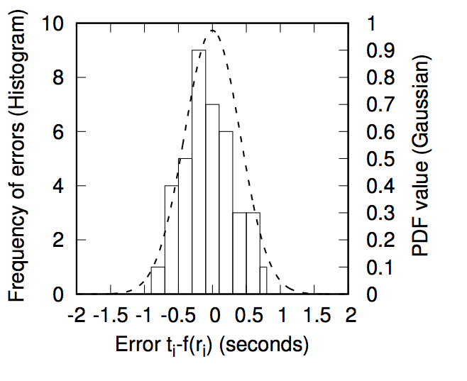
Linear Regression Function and Its Uncertainty
Notes:
Note that the regression function is request-dependent. hurricane has one, and the sunny query has another one.
due to the data skew and fluctuation of the underlying system, even for a same request the function can changes over time.
The uncetainty model can be generated by the difference between the predicted value and the actual running time.
we implemented two models to capture the errors: histogram to record the number of frequency of errors. and gaussian function to record the standard deviation.

Slide 28
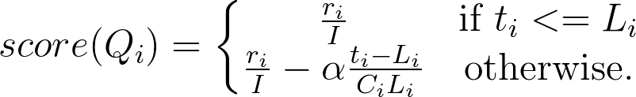
Tradeoff of Running Time and Penalty
Progress
Delay
r_{i} : Size of range predicate
I : Total interval of the slicing attribute
α : Weight on penalty
t_{i} : Actual running time
L_{i} : Time Limit of Q_{i}
C_{i} : Total number of mini-queries (estimation)
Notes:
how to utilize the model to decide the ri?
When deciding the predicate range for the next mini-query, if we choose a larger range, the total running time can be reduced, since there will be fewer queries, but it may have a high risk of missing the next deadline. to consider the tradeoff between the total running time and the penalty, we define a score function to evaluate each mini-query
the figure compares the score of two choices of r_{i} , the left part choose a 16 days range, and the right one choose a 12 days range. the 16 days option makes more progress, thus the score is high if the actual running time is less than the time limit. However, based on the uncertainty model, a more conservative option will have lower risk of missing the deadline.
too much

Slide 29
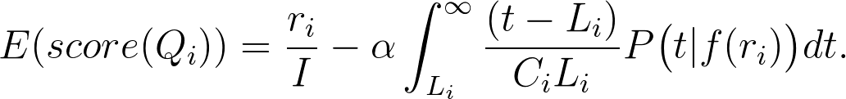
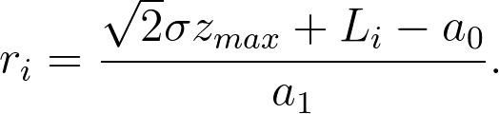
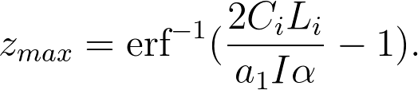
Choosing r_{i} to Maximize the Expected Score
Optimized r_{i} using Gaussian model:
Notes:
Thus, the task is to choose a ri to maximize the expected score so that it can finish as close to the deadline Li as possible, but have less risk of running longer than it.
As ri increases, initially the exp score also increases since the progress increases withou much penaly, after a certain time the exp score starts declining since the risk of having penalty becomes high. There is an optimal ri that can achieve the best exp score. And the opt value depends on the penalty weight alpha.

Slide 30
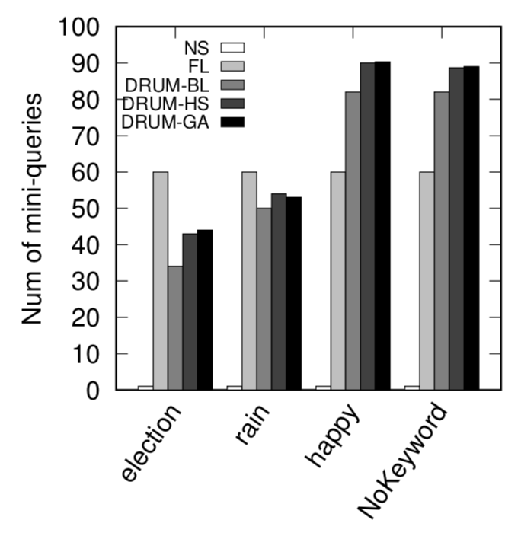
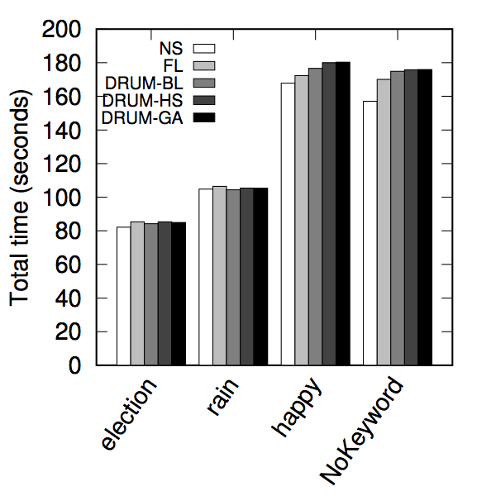
# of mini-queries and total running time
Notes:
good: slicing doesn’t introduce much overhead.

Slide 31
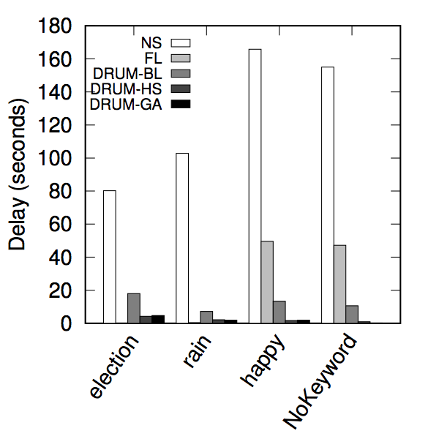
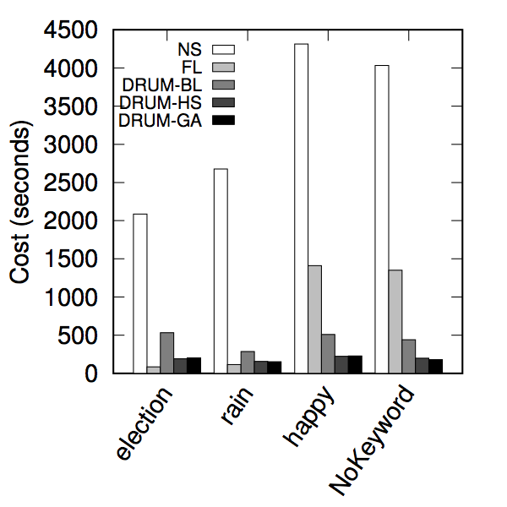
Total delay and overall cost
α=25

Slide 32






Understand Big Data
Notes:
story!

